Slide 1
Retrieval Augmented Gneneration

Slide 2
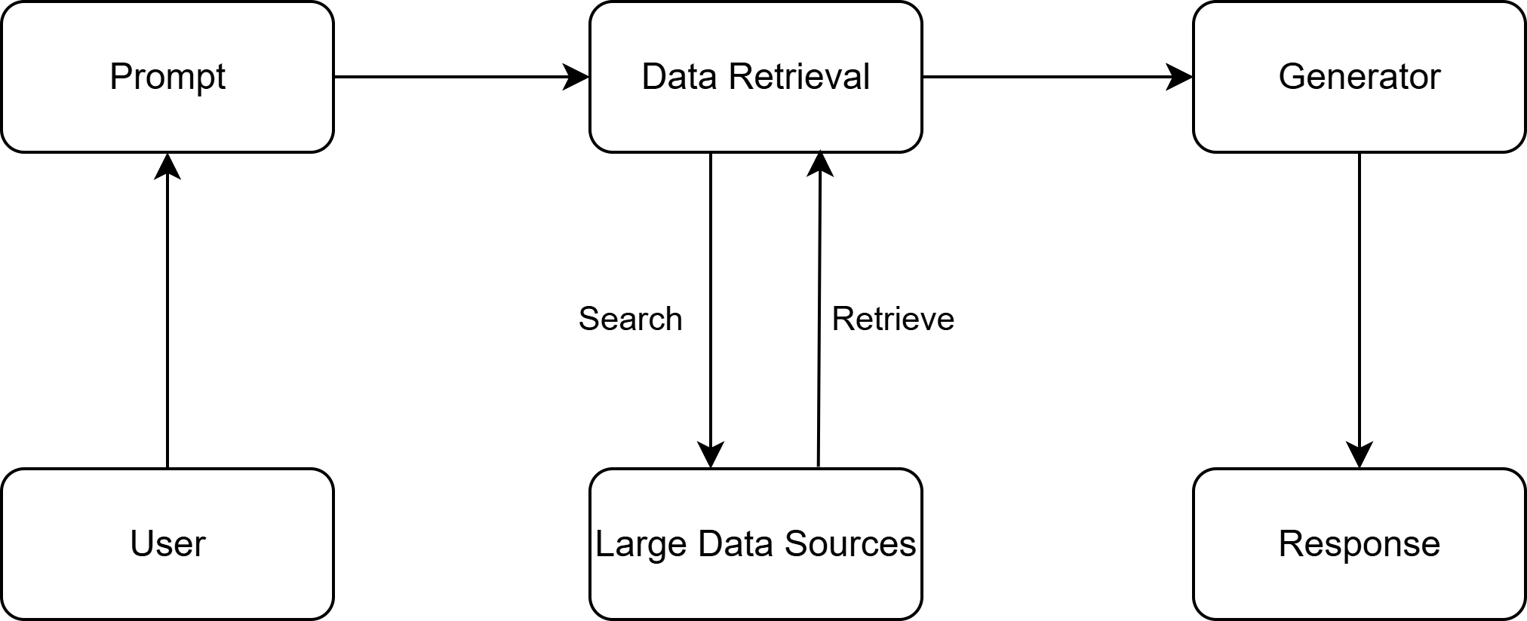
RAG Pipeline

